Slide 1
New plots summary
04/02/2024
Figure 5 in EAD Draft 4
Takashi NLH

Slide 2
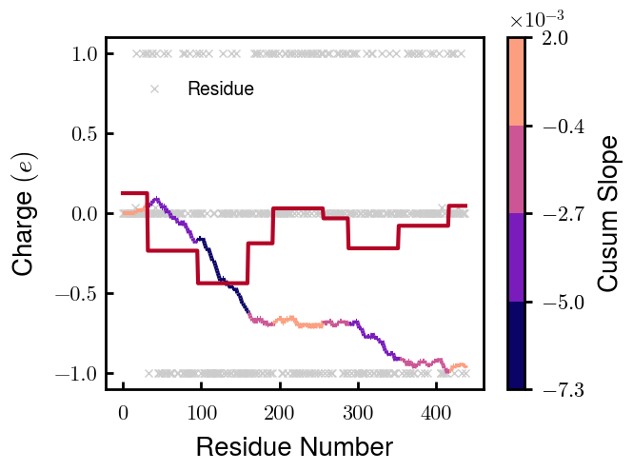
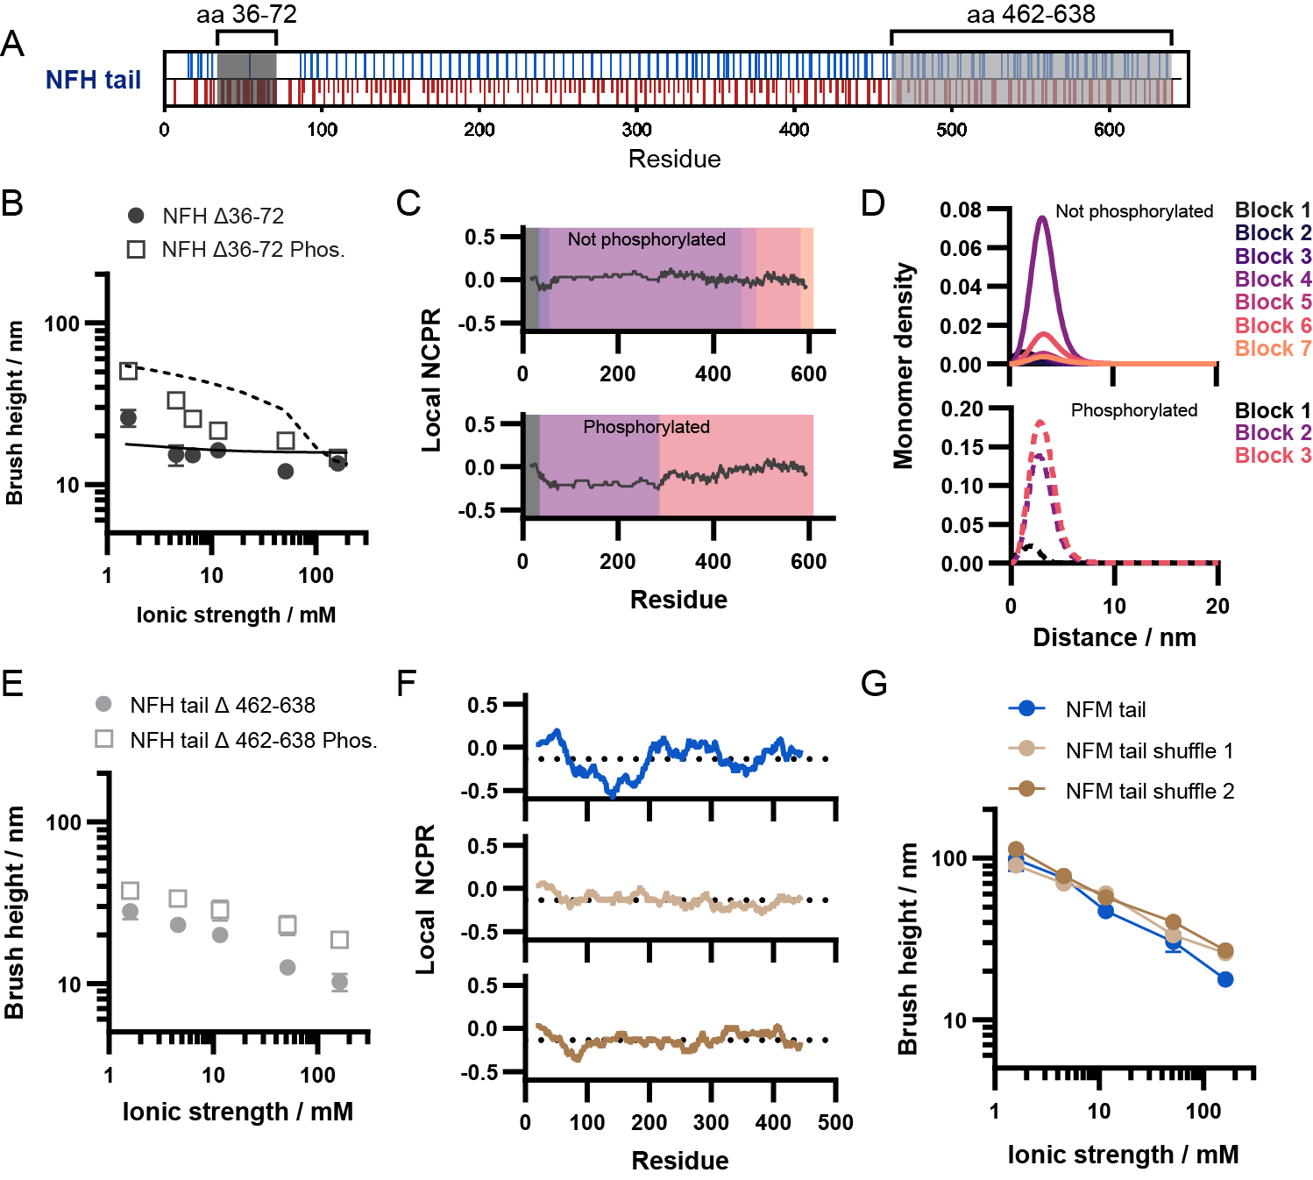
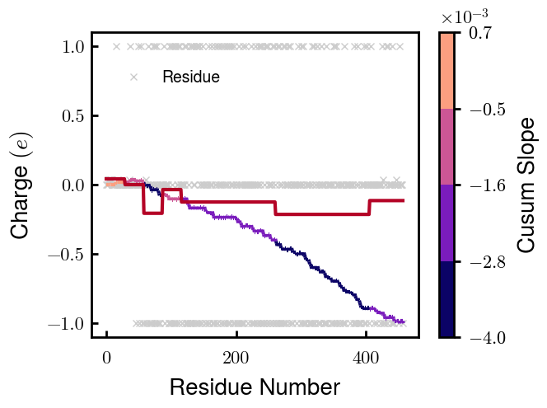
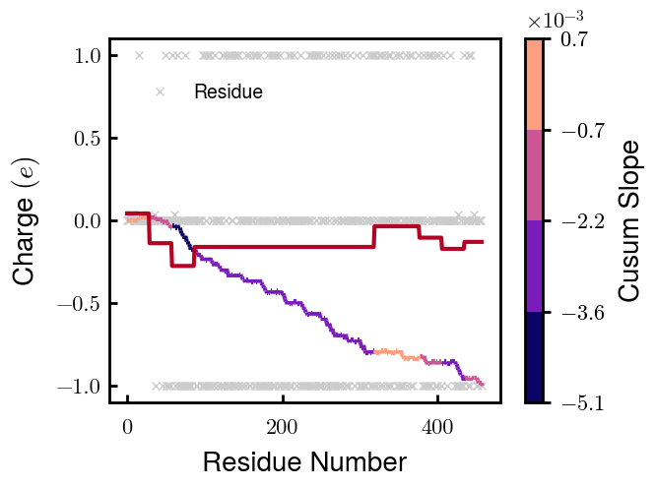
Mshuf Charge distributions
NFM
N = 9
N = 7
S1
N = 8
S2
N = 1
Even
(but keeping the same 9
chi blocks as NFM)

Slide 3
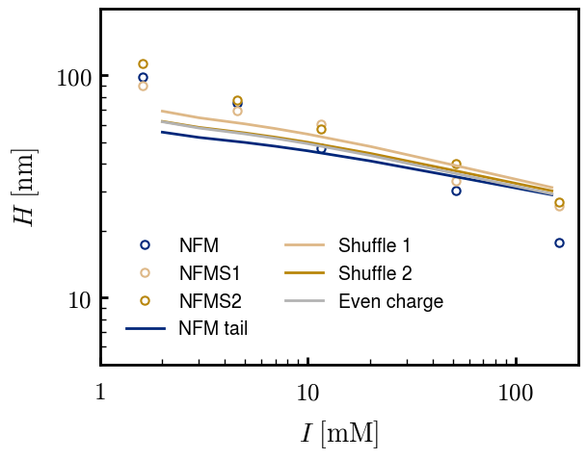
Mshuf Height response
Key characteristics:
S1 & S2 taller than NFM for all ionic strengths
Height increase from S1 & S2 could be from increased grafting density of their brushes compared to NFM
Grafting density used for Even is same as NFM

Slide 4
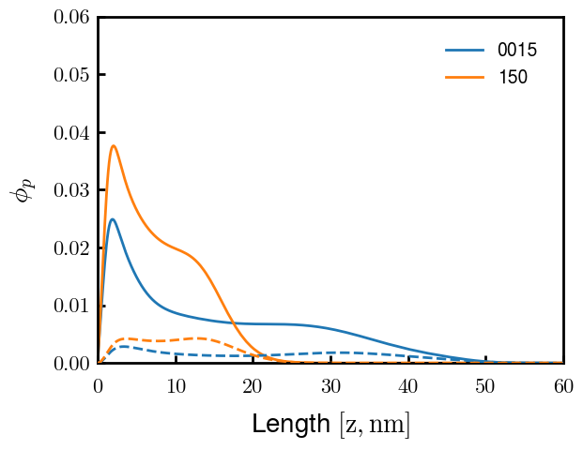
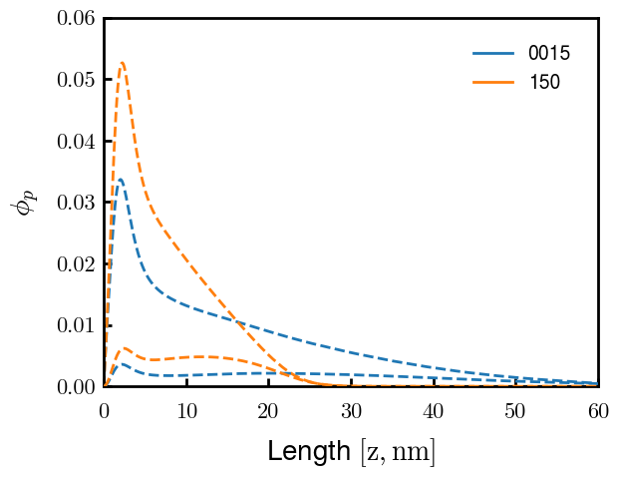
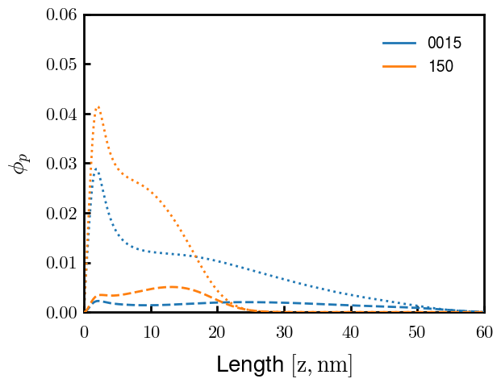
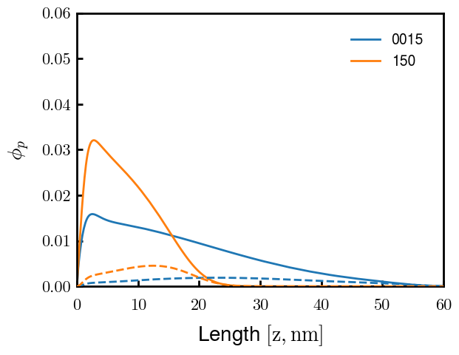
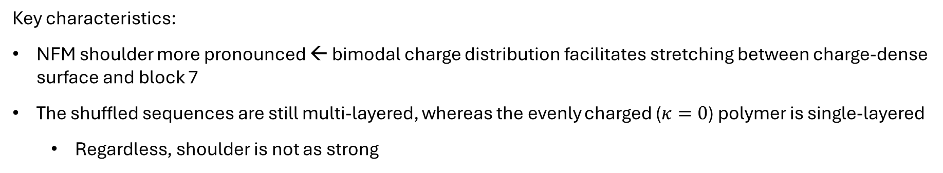
Mshuf Morphologies (end-block in parentheses)
NFM (block 9)
S1 (block 7)
S2 (block 8)
S0 (block 9)
Key characteristics:
NFM shoulder more pronounced ← bimodal charge distribution facilitates stretching between charge-dense surface and block 7
The shuffled sequences are still multi-layered, whereas the evenly charged ($κ=0$) polymer is single-layered
Regardless, shoulder is not as strong
Note: blocks do not exactly line up (see Slide 2)

Slide 5
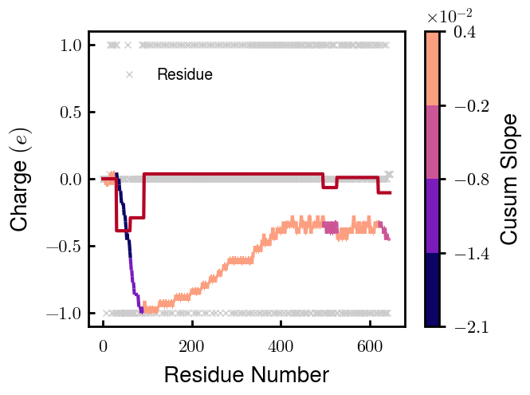
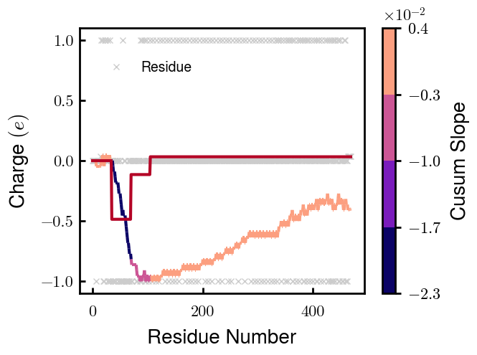
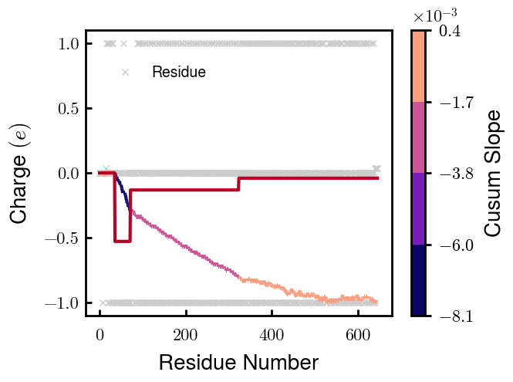
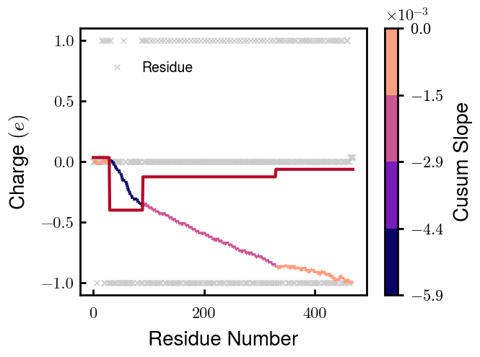
HD6 Charge dists
NFH
NFH_DE-4
pNFH
pNFH_DE

Slide 6
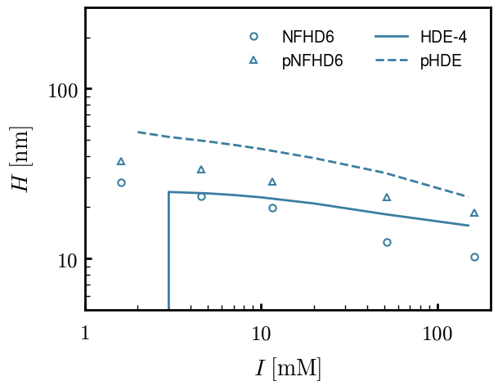
Height response

Slide 7

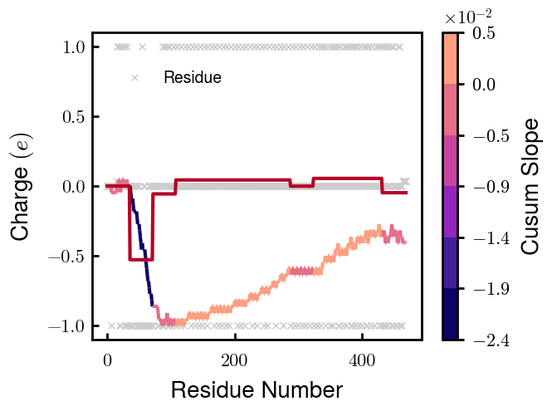
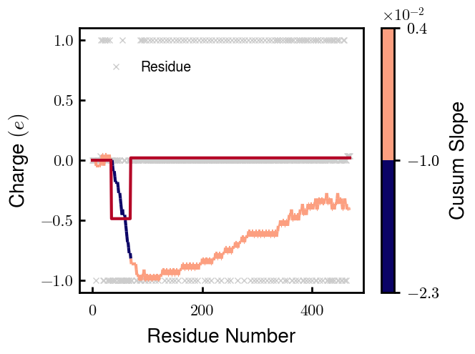
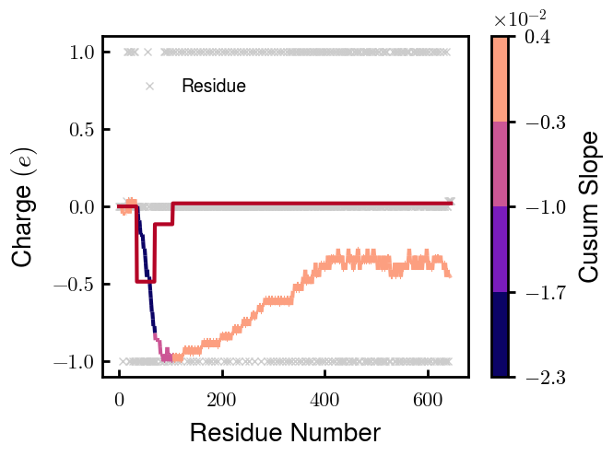
Temp - D6
pNFH
NFH_DE
NFH
NFH_DE-2
pNFH_DE
NFH_DE-3
NFH2
NFH_DE-4
prog

Slide 8
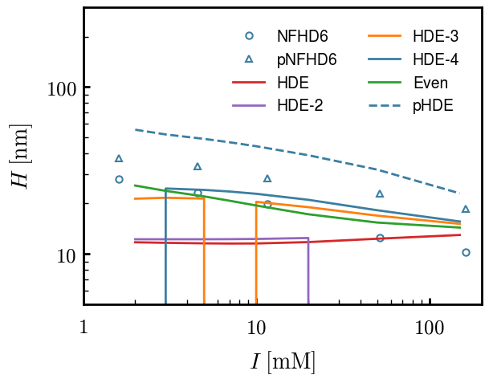
Height response

